Slide 1
The diverse brides

Slide 2
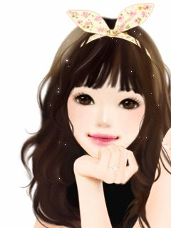
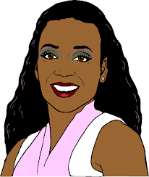
Mom, I have something to share….
Something special!!!

Slide 3

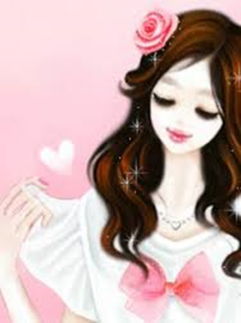
Really!!!
Oh I was waiting for this for so long!
I am excited
I think I am ready to get married
I can’t wait to share this news with my friends

Slide 4
